Slide 1

Spring Boot Part 3

Slide 2
Agenda
Homework 2 answer
CORS introduction
Processing Complicated JSON
Calling Another Project’s Web Services
Add Another Project onto Existing Project

Slide 3
CORS - Cross-Origin Resource Sharing
Cross-origin resource sharing (CORS) is a mechanism that allows restricted resources (e.g. fonts) on a web page to be requested from another domain outside the domain from which the resource originated.
CORS defines a way in which a browser and server can interact to safely determine whether or not to allow the cross-origin request. It allows for more freedom and functionality than purely same-origin requests, but is more secure than simply allowing all cross-origin requests. It is a recommended standard of the W3C.
How CORS Works?
The CORS standard describes new HTTP headers which provide browsers and servers a way to request remote URLs only when they have permission. Although some validation and authorization can be performed by the server, it is generally the browser's responsibility to support these headers and respect the restrictions they impose.

Slide 4

Setting CORS Authorization
Error occurred when server get request from ajax with no CORS setting
CORS Setting can be set on different levels:
Method level
Controller level
Global

Slide 5
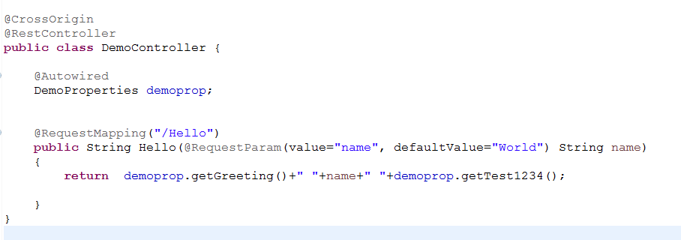
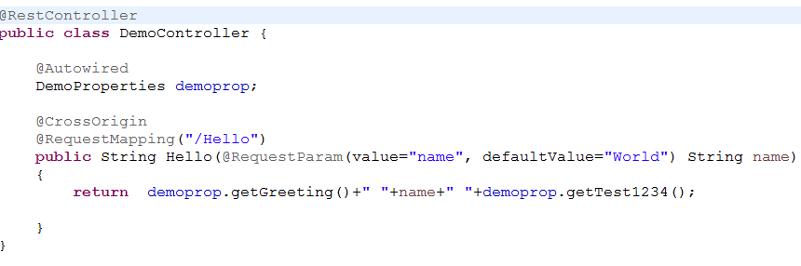
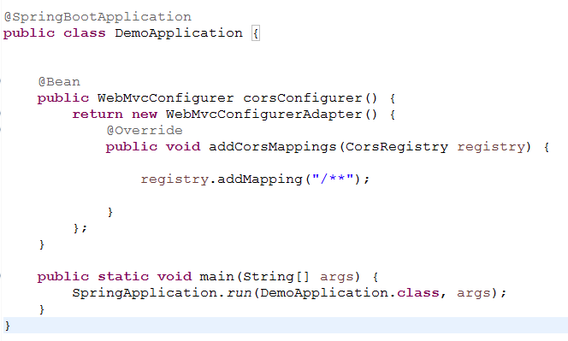
Setting CORS
CORS for the whole controller
CORS configuration on method level
Global CORS configuration

Slide 6
Processing Json Example
1
2
3
{ "name":"Chandra", "address":"Hsinchu" }
[ { "name":" Tom", "address":" Hsinchu" }, { "name":"Chandra", "address":" Hsinchu" } ]
{ "users":[ { "name":" Tom", "address":" Hsinchu" }, { "name":"Chandra", "address":" Hsinchu" } ], "otherUser":{ "firstName":"foo", "lastName":"bar" } }

Slide 7
Continue
4
[ { "token":"test123" }
, { "name":"chandra“,
“address”:”hsinchu” } ]
5
{ "Result":"0000000", "Message":"OK", "ResponseObject":{ "PartNumber":{ "11006661001-C$01":78681.0, "56.07B04.051":80896.0, "55.64Q09.D01G":78817.0, "31986100":82229.0, "34.63Y04.001":77306.0, "55.67E01.M01G":80501.0, "47.60X01.001":77711.0, "57.6C509.S08":79729.0 }, "PartNumberCount":8, "SpendTime":15 } }

Slide 8
Call Another Project’s Web Service
http://10.37.36.111/AvatarWebApi/wwwroot/api/ForecastWeather POST
[ { "Token":"SAP" }, { "name":"hsinchu", "language":"en" } ]
Needed Object to Call WebService:
org.apache.http.impl.client.CloseableHttpClient
org.apache.http.client.methods.HttpPost
org.apache.http.HttpResponse

Slide 9
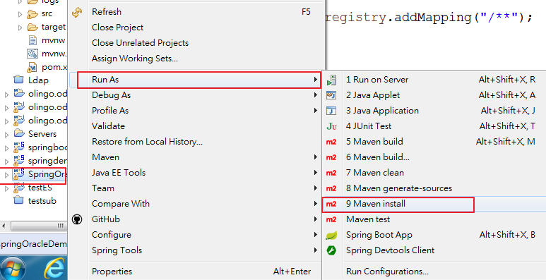
Add Another project into current project
1

Slide 10
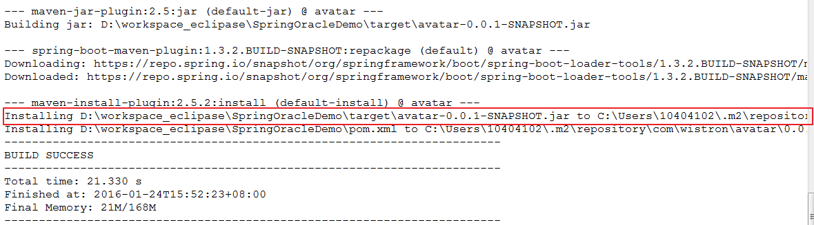
Continue

Slide 11
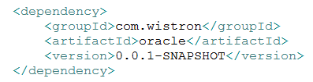
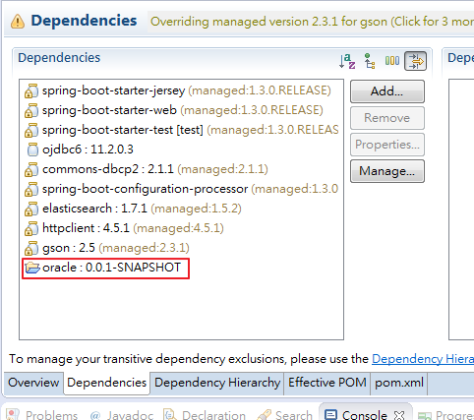
Setting POM file
2

Slide 12
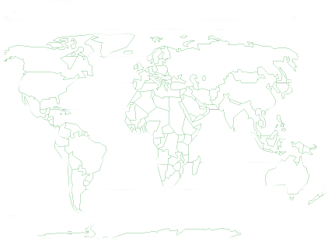

Thank You !

